Slide 1
Struts Core
Struts Core @ Ford

Slide 2
Agenda
Opportunity Statement
Charter Statement
JAB Blue Print
Tiers
JAB Application Architecture
Presentation Layer - Struts Core
Why Struts Core?
Struts Core Implementation
Struts Core - Additional Functionalities
Form Bean
Controller Action Class
Action Flow Example
Configuration
Strutscore-Config.xml
Declarative Logging
Authorization
Validation
Required Jars In Struts Core
Packaging View
Deployment View

Slide 3
Opportunity Statement
The Java Center of Excellence observed that Ford Motor Company has demonstrated global inconsistency in the source code developed for Java applications.
This lack of project consistency has negatively impacted development speed, agility, and on-going cost of maintenance.

Slide 4
Charter Statement
'JCOE Adventure Builder' (JAB) - To illustrate to Ford developers the recommended “Implementation Patterns” in a working reference application.

Slide 5
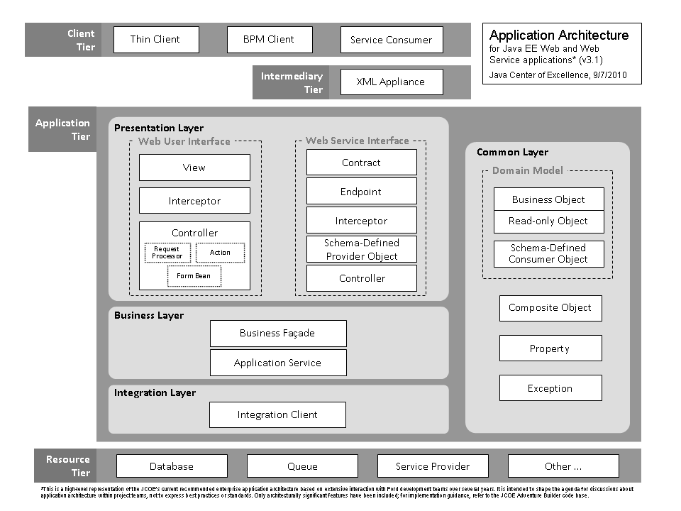
Current JAB Blue Print

Slide 6
Tiers
Client Tier - Responsible for requesting data from the Application Tier then formatting and optionally displaying the result
Application Tier - At Ford, the Application Tier resides in a single JVM and is composed of 4 Logical Layers
Resource Tier - Comprised of external resource(s) the Application Tier interfaces with in order to provide business functionality
    Database
    Web Service

Slide 7
Application Tier - Logical Layers
Presentation
  Actions are only responsible for navigation
  Form Beans encapsulate Domain Objects
  Form Beans interact with Business Layer by calling methods on a Business Façade
  Domain Objects are passed to/from the FormBean and Business Facade
Business
  Business Façade interacts with Application Services
  Application Services are technology focused
    PersistenceAS & WscConsumerAS
Integration
  Boundary layer for Resource Tier interaction
Common
  Domain Objects belong to the Common Layer because they can be accessed by all other Layers
  Common Layer components should not have dependencies on the Business or Presentation Layer

Slide 8
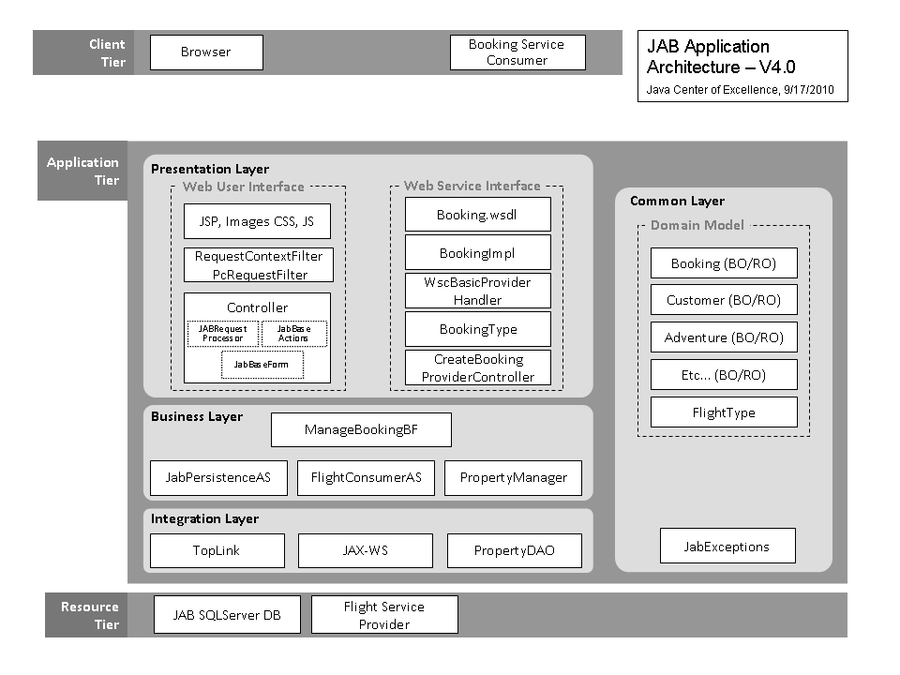
WsCore
ITCore
StrutsCore
Persistence
&
Persistence
Core
WsCore
ITCore
Slide 38

Slide 9
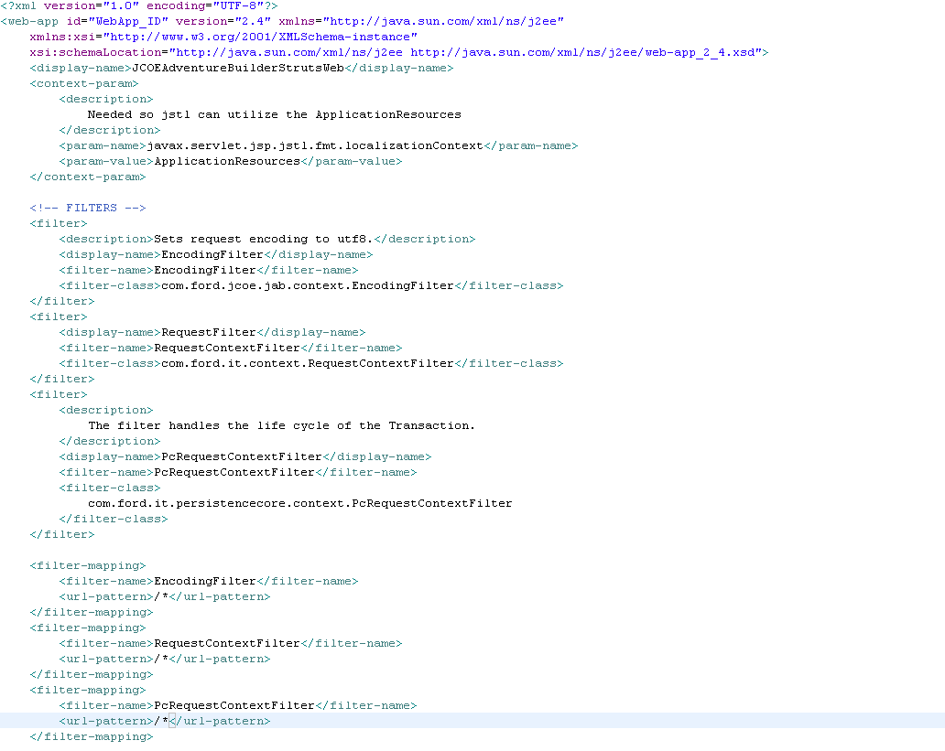
Web.xml

Slide 10
Presentation Layer - Struts Core
Enables a standard Ford web-application presentation layer development protocol including associated automated method (or unit) tests.
The intent is to deliver business functionality with as few maintenance points as possible.
It is asserted that consistently applied implementation patterns promote agility and velocity throughout an application Systems Development Life Cycle and that consistency across an enterprise magnifies the positive impact.
Struts Core is a logical extension of the Struts Framework v1.x.
Lookup Dispatch Form Processing

Slide 11
Why Struts Core?
Exceptions (Contextualized for Ford)Exceptions are contextualized for Ford Motor Company
  Converts any Struts exceptions to a Ford self-logging runtime exception (that only logs once).
  Explicitly identifies the layer of the stack challenging the exception.
  Intelligent Exceptions
  Exceptions thrown before logging.
Logging (Insightful): Logging provides insight into internal framework processing
  Several of the 18 Struts Lifecycle phases are logged with request/response feedback.
  Value-added logging is declaratively activated and is independent of log level.
  Exceptions are logged once
  Logging of exceptions at the point it is thrown.

Slide 12
Why Struts Core?
Limiting (API):Limited API is published
  A reduced set of choices is exposed by the StrutsCore API. This lessens the need to evaluate and select Struts capabilities best contextualized for the Ford environment.
  A limited API does not encumber an application from bypassing 'core' framework classes and invoking native (Struts framework) functionality directly.

Slide 13
Why Struts Core?
Pattern (Enforcement): Pattern enforcement of coding conventions
  Several class naming conventions are enforced by a coding convention exception thrown upon instantiation.
  Action classes
  Form Bean classes
  Several method naming conventions are enforced by a coding convention exception.
  Validate methods in Form Beans
  Navigate methods in Action Classes

Slide 14
Struts Core - Additional Functionalities
Authorization
  Plugins for 'request authorization' accommodated. ScTilesRequestProcessor.processAuthorization()
  'View authorization' supported with a set of JSP tags.
    IsAuthorizedForAllTag / IsAuthorizedForAnyTag /
    NotAuthorizedForAllTag / NotAuthorizedForAnyTag
Session Expiration
  A default implementation provided for session expiration.
Token Synchronization
  A default implementation provided for token synchronization.
Lookup Dispatch Form Processing
Default implementation for resolving validation methods
is supported.
Default Button Support (Back, Cancel, NO)
Chained Action Support for Navigation.

Slide 15
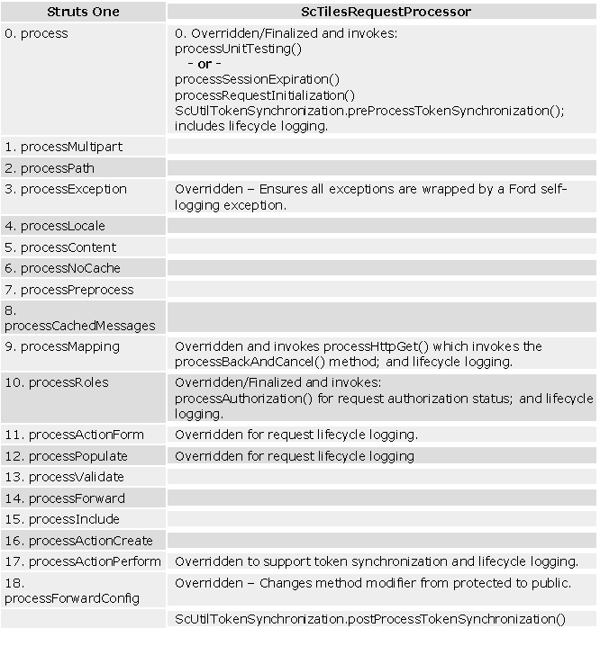
Request Processor

Slide 16
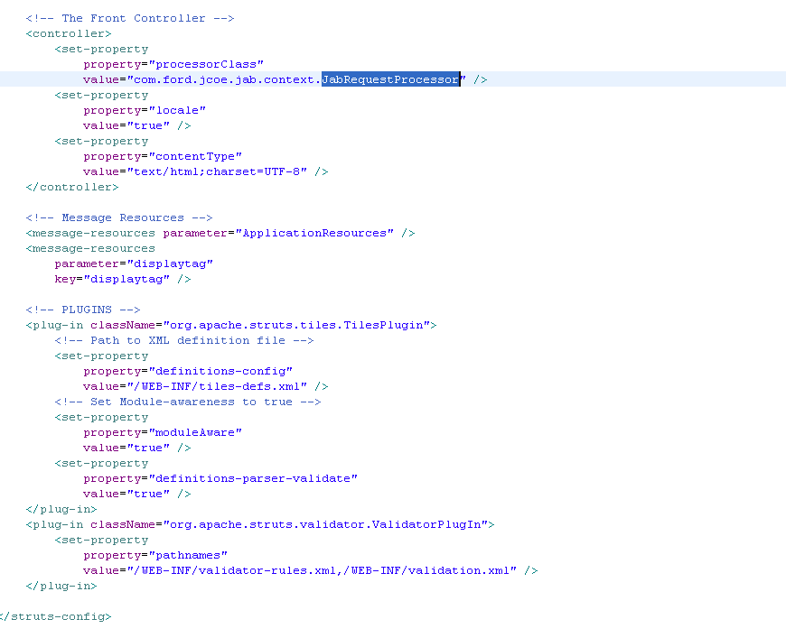
Struts-config.xml
Notes:
Register Request Processor
Form Declarations

Slide 17
ApplicationResources.properties
Buttons
  button.strutscore.httpGet.default=httpGet
  button.strutscore.cancel.default=Cancel
  button.searchBooking=Search
Labels
  label.home.actions=Actions
  label.home.adventure=Adventure
Messages
  errors.required={0} is required.

Slide 18
Form Bean Characteristics and Design
Controller component containing the Model (MVC Pattern)
Model consists of domain objects
Interacts with Business Layer via Business Façade (BF)
Establish transaction boundaries to define a minimal number of form beans
Extend ScBaseLDForm
Use consistent method verbs
  ‘populate’
  ‘process’
  ‘validate’ (Coding Convention Exception)
Include a static instance of required Business Façades
Determine fields from wireframes

Slide 19
Form Bean Declaration – Struts Config
<form-bean
name=“createBookingForm“
type="com.ford.jcoe.jab.formbean.CreateBookingForm">
<display-name>
createBookingForm
</display-name>
</form-bean>
Notes:
Form should always be specified at Session Scope
Transaction initiation from Form Bean
Default Method is “HttpGet”
Default Parameter value is “method

Slide 20
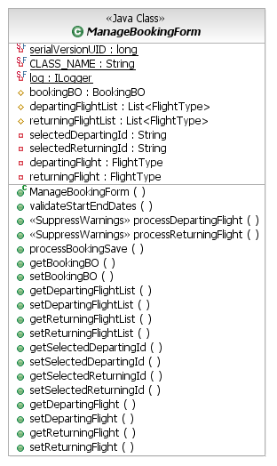
Form Bean class diagram

Slide 21
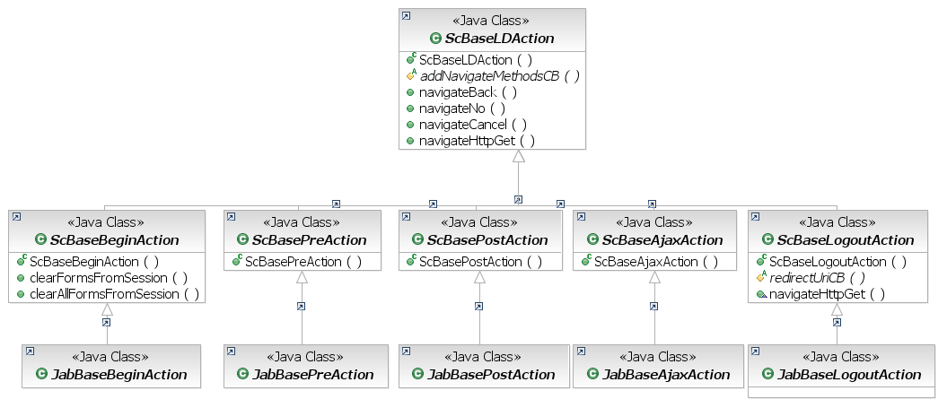
Action – Class Diagram

Slide 22
Controller Action Class
Begin Action
  Begin a transactional sequence
  Clear stale form beans from session
Pre Action
  Occurs just prior to a page being rendered
  Calls ‘populate’ methods on the form bean to stage data (i.e. drop down box)
Post Action
  Invoked after a user action (i.e. button press) from a displayed page
  Calls ‘process’ methods on the form bean
AJAX Action
  Invoked by an AJAX request
Logout Action
  Invoked by a user
  Ensures resources are released (i.e. session)
  Redirects to desired page after logout

Slide 23
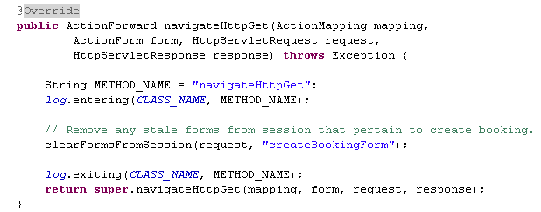
Begin Action : Remove stale Data
Remove any stale form beans from session
Not associated with any Form
Chain to a Pre Action

Slide 24
Action Flow Example – Begin Action
Example BeginAction:
<action
path="/updateOptionsBegin"
type="com.ford.jcoe.jab.action.booking.update.
UpdateOptionsBeginAction"
parameter="method"
validate="false"
roles="UpdateBooking:execute">
<forward name="httpGet"path="/updateOptionsPre.do"/>
</action>

Slide 25
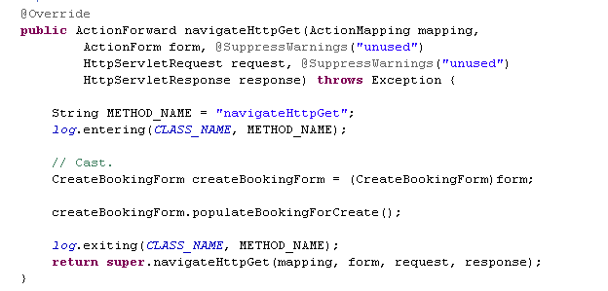
Pre Action : Prepare for View of JSP
Invoke populate Methods on the form
Usually forwards to a tile.

Slide 26
Action Flow Example – PreAction
Example PreAction:
<action
path="/updateOptionsPre"
type="com.ford.jcoe.jab.action.booking.update.
UpdateOptionsPreAction"
name="updateBookingForm"
scope="session"
validate="false"
parameter="method"
roles="UpdateBooking:execute">
<forward name="httpGet" path="tile.updateBooking"/>
</action>

Slide 27
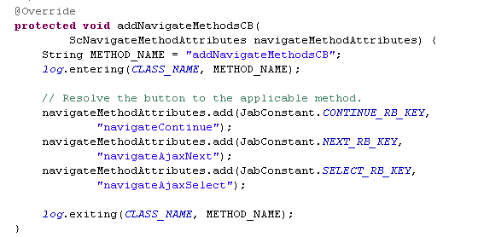
Post Action : Process buttons on JSP
Navigation CB method
  Resolves buttons on the JSP to navigate methods on the action
Invoke the Process method on the Form(navigateAjaxLoadCities, navigateAjaxLoadStates, navigateAjaxNext, navigateContinue)

Slide 28
Action Flow Example – Post Action
Example PostAction:
<action
path="/updateOptionsPost"
type="com.ford.jcoe.jab.action.booking.update.
UpdateOptionsPostAction"
name="updateBookingForm" scope="session"
validate="true" input="tile.updateBooking"
parameter="method"
roles="UpdateBooking:execute"
cancellable="true">
<forward name="save" path="tile.viewBooking" />
<forward name="cancel" path="tile.viewBooking"
redirect="true" />
</action>

Slide 29
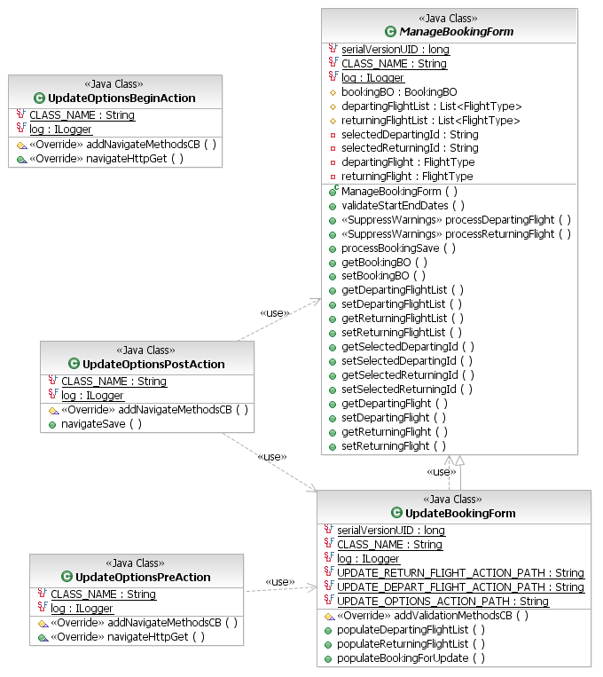
Action Class Diagram

Slide 30
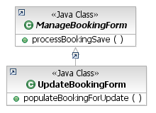


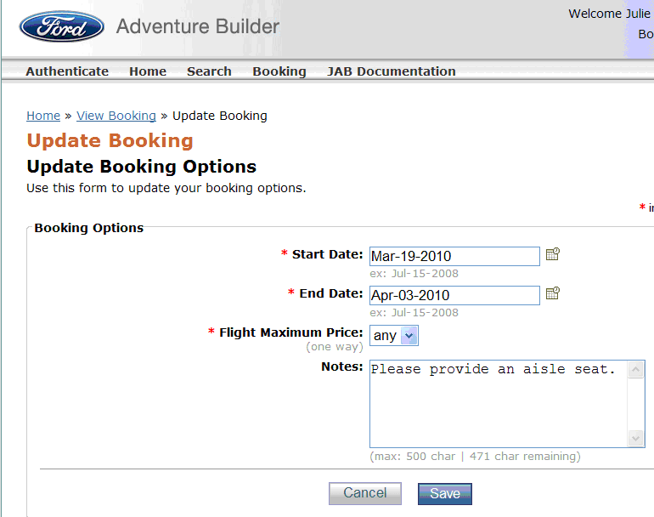

Update Booking Sequence
Next Action
or Tile
clearFormsFromSession()
forward to
next Action or Tile
processBookingSave()
forward to /updateOptionsPre.do
populateBookingForUpdate()
form action=
/updateOptionsPost
forward to
/tile.updateBooking
Page <number>

Slide 31
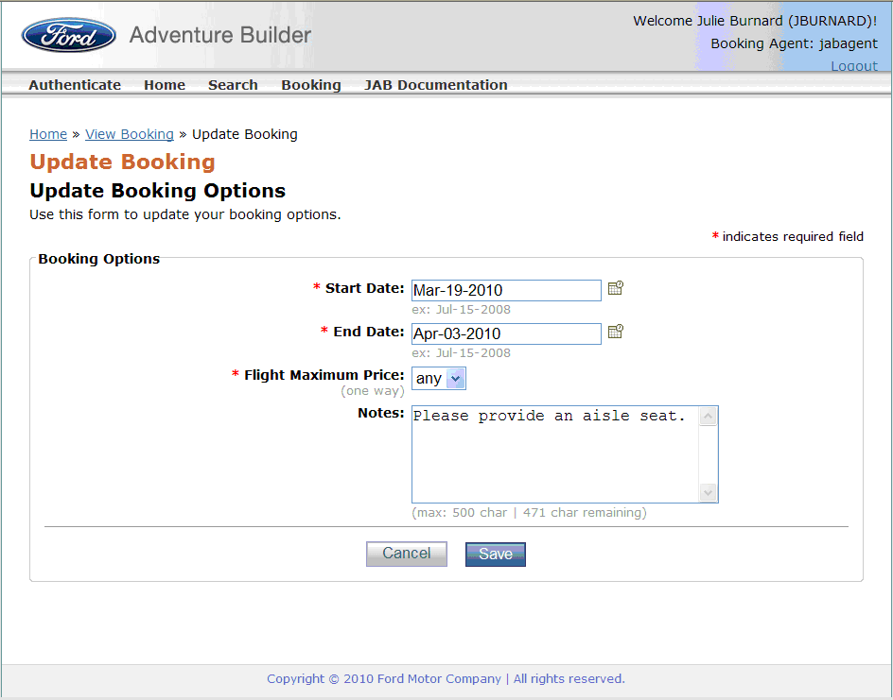
Tile

Slide 32
Configuration Files
struts-config.xml
strutscore-config.xml
fjf-security-plugins-config.xml
web.xml
tiles-def.xml
applicationResources.properties

Slide 33
StrutsCore Declarative Logging
<!-- Declarative Logging - Log statements are on (true) or off (false). Normally activated (true) during development only.
-->
<property-group name=" DeclarativeLogging">
<property name="requestReceived">true</property>
<property name="requestLifecycle">true</property>
</property-group>

Slide 34
StrutsCore Declarative Logging
<< StrutsCore v. 1.0.4; Method=GET; URI=/JCOEAdventureBuilderStrutsWeb/viewBookingPre.do; Reentrant #=1;
StrutsCore ==> Lifecycle phase [ProcessMapping] – ActionConfig[cancellable=false, path=/viewBookingPre, validate=false, name=bookingForm, type=com.ford.jcoe.jab.action.booking.view.ViewBookingPreAction

Slide 35
StrutsCore Declarative Validation
During development it is helpful to turn off validation while initially setting up declarative navigation
StrutsCore enables suppressing validation declaratively
<property-group name="Validation">
<property name="suppressValidation">true</property>
</property-group>

Slide 36
Declarative Validation
Struts declarative validation is defined in:
  JCOEAdventureBuilderStrutsWeb/
  WebContent/WEB-INF/validation.xml
Struts comes with some pre-defined validation rules located in
  JCOEAdventureBuilderStrutsWeb/
  WebContent/WEB-INF/validator-rules.xml

Slide 37
Declarative Validation
<!-- update bookings -->
<form name="/updateOptionsPost">
<field property="selectedStartDate" depends="required,date">
<arg0 key="label.bookingBO.startDate" />
<var>
<var-name>datePattern</var-name>
<var-value>MMM-dd-yyyy</var-value>
</var>
</field>
<field property="selectedEndDate" depends="required,date">
<arg0 key="label.bookingBO.endDate" />
<var>
<var-name>datePattern</var-name>
<var-value>MMM-dd-yyyy</var-value>
</var>
</field>
</form>

Slide 38
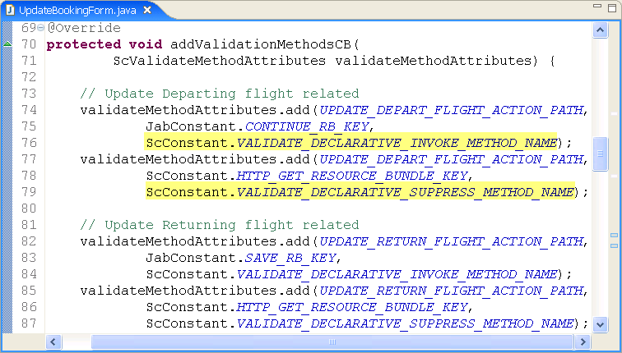
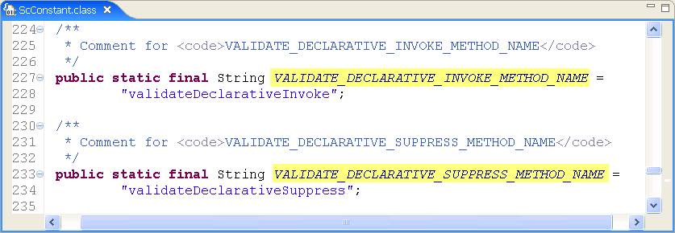
Programatic Validation
Form Validation invocation is controlled through the addValidationMethodsCB() method:

Slide 39
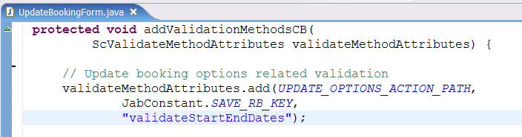
Programmatic Validation
In the addValidationMethodCB() method, add the validation method to the map:

Slide 40
Layout
Review the tiles layout classes and CDU related artifacts
  tiles-defs.xml
  jsp/layout directory
  jsp/include directory
  FJF Menu component (included in layout)
    menuContent.xml

Slide 41
Required Jars In Struts Core
strutscore-fjf.jar
struts-core-1.x.x.jar
    struts-el-1.x.x.jar
    struts-extras-1.x.x.jar
    struts-faces-1.x.x.jar
    struts-scripting-1.x.x.jar
    struts-mailreader-dao-1.x.x.jar
    struts-taglib-1.x.x.jar
    struts-tiles-1.x.x.jar
itcore.jar
commons-validator-1.x.x.jar
commons-lang-2.x.jar

Slide 42
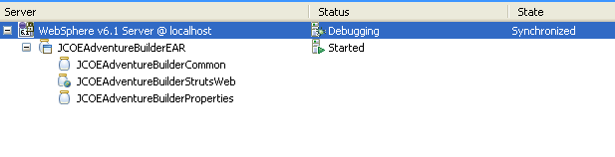
Packaging View
JCOEAdventureBuilderEAR
JCOEAdventureBuilderStrutsWeb
JCOEAdventureBuilderCommon
JCOEAdventureBuilderProperties

Slide 43

Deployment View
Client Tier
Resource Tier
JAB DB
WebServer
(images, css, js)
WAS
Application Server
(JAB.ear)
WebServer
(images, css, js)
WAS
Application Server
(JAB.ear)
FlightService
Slide 5

Slide 44
Links
StrutsCore
https://www.tc2.ford.com/ts/JCOE/Java%20Technologies%20Wiki/JAB.aspx
JAB
  https://www.tc2.ford.com/ts/JCOE/Java%20Technologies%20Wiki/Struts.aspx

